Slide 1
AGILE AND SCRUM

Slide 2
What is agile?
Conventional software models like Waterfall Model had a lot of flaws hence Agile came into picture.
It's a practice used for continuous iteration of development and testing in the SDLC.
Breaks the project in chunks or smaller segments so, clients will be able to see the progress of projects constantly.
More adaptable to changing requirements.
Encourages F2F communication, teamwork and constant feedback from the end users.

Slide 3
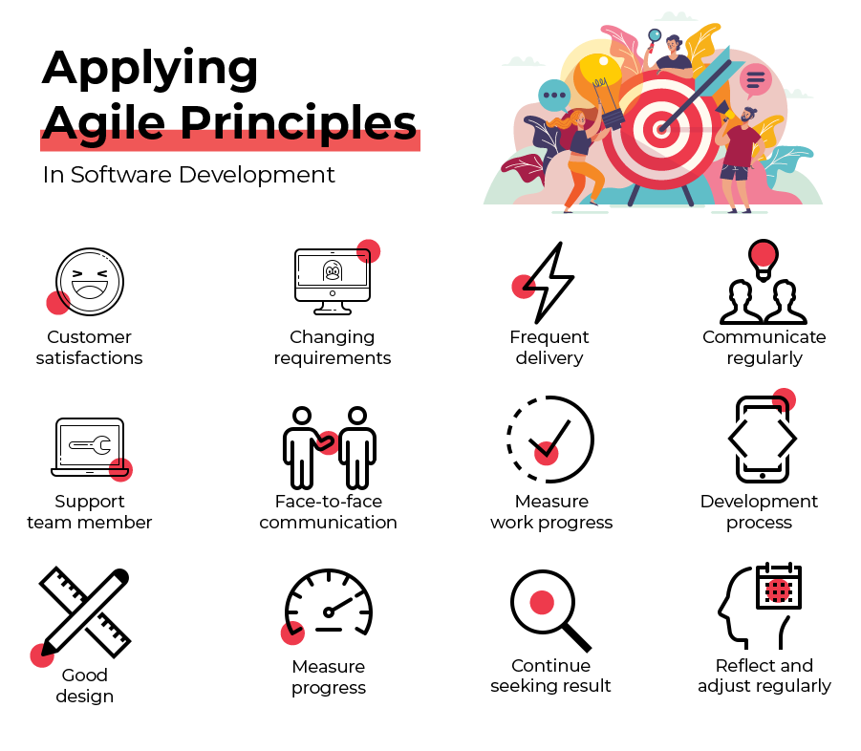
12 principles of agile software development

Slide 4
Advantages of agile
Open to Changes
Highest preference to customer satisfaction
Faster and high-quality product delivery
Strong team interaction

Slide 5
Disadvantages of agile
Time commitment from developer's side
Requires skill and training to implement feedback

Slide 6
What is scrum?
Popular approach or model to implement Agile methodology
Helps users to manage software development with iterative method
Regular and repeatable work cycle in scrum during which work is completed and made ready for reviews is known as scrum sprint
Sprints hardly lasts for 1-2 weeks and for next sprint plan is made by team workers
For incremental feedback burndown charts or boards are used

Slide 7
Advantages of scrum
Cost effective
Easy to make changes
Provides continuous feedback

Slide 8
Disadvantages of scrum
Requires experience
Final project's deadline isn't accounted

Slide 9
Agile vs scrum
CONCEPT ROLES AND RESPONSIBILITIES FEEDBACK DELIVERY AND UPDATE | AGILE Development strategy based on incremental and iterative approach Leadership plays an important role Frequent delivery is needed to the end user for their feedbacks Highest priority given to customer's satisfaction by providing valuable software products | SCRUM Popular framework to implement agile methodology for software development Supports self-organizing and cross-functional team Daily scrum meeting to receive feedback for future progress of the project Delivers product end of each sprint and regular feedback from clients are taken before next sprint

